Slide 1
BIOCHEMISTRY PRACTICAL Abnormal constituents of Urine
Dr Reshmy K.R
Professor
Department of Physiology
SKHMC

Slide 2
Abnormal constituents of Urine
1. Reducing Sugar
2. Proteins
3. Ketone Bodies
4. Bile salts
5. Bile Pigments
6. Blood

Slide 3
1.Benedict's test
To 5ml of Benedict’s reagent add 8 drops of sample solution of urine and heat it for 2 minutes.
Colour changes from blue to green to yellow to brown to orange to red precipitate.

Slide 4
When Benedict’s solution and simple carbohydrates are heated, the solution changes to orange red/ brick red.
This reaction is caused by the reducing property of simple carbohydrates.
The copper2+ ions in the Benedict’s solution are reduced to Copperic ions, which causes the color change.
The red copperoxide formed is insoluble in water and is precipitated out of solution.
As the concentration of reducing sugar increases, the nearer the final colour is to brick-red and the greater the precipitate formed.
Sometimes a brick red solid, copper oxide, precipitates out of the solution and collects at the bottom of the test tube.

Slide 6
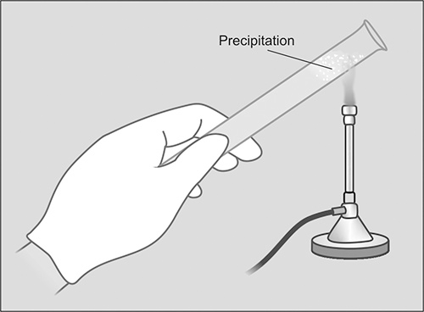
2.Heat coagulation test
Heat & Acetic acid test
To 10ml of urine in a test tube heat only the upper portion of urine to boil and add acetic acid to the sides of the test tube.
Turbdity in the upper part due to coagulum which doesn’t dissolve in acetic acid.

Slide 8
When a protein is heated in acidic medium ,it becomes denatured due to breaking up of certain bonds.
However when the coagulable proteins are heated at their isoelectric pH,its polypeptide chains becomes uncoiled and matted with each other to form an insoluble mass.
The process of coagulation is maximum at the isoelectric pH of the protein.
While a denatured protein may be restored to its original structure and function by certain manipulations, coagulation is an irreversible process.

Slide 9
Acetic acid present in the reagents breaks down peptide bonds on heating.

Slide 10
2.Heller's test
White ring at the junction of two liquids.
Principle
strong acids like Nitric acid causes the denaturation of precipitated proteins.

Slide 11
Hellers test

Slide 12
Conditions in which Protein is present in Urine
Proteinuria - Presence f Protein in Urine

Slide 13
Proteinuria

Slide 14
3. Ketone bodies-Rothera's Test
Saturate 5ml of urine with ammonium sulphate crystals. Then add 2 drops of freshly prepared 5% sodium nitroprusside. Mix well and add 1ml of strong liquor ammonia along the sides of the test tube.
Purple ring develops

Slide 15
3.Test for Ketone bodies-Rothera's test

Slide 16
Ketoneuria-causes
Uncontrolled D.M
Starvation
High fat feeding
Heavy exercise
Toxemias of Pregnancy
Ketonuria- Presence of Ketone bodies in Urine.

Slide 17
Gerhardt’s test
To 3ml urine add few drops of 10% Ferric chloride solution.
Port wine colour develops--Acetoacetic acid is present

Slide 18
Clinical conditions

Slide 19
4. Bile salts
Hay’s Sulphur test
Take 5ml of urine in a test tube.Sprinkle gently a pinch of sulphur powder.
Sulphur powder sinks at the bottom of the test tube
Bile salts lowers the sulphur tension of the liquid

Slide 20
Principle

Slide 21
4. Bile Pigments
Fouchet’s test
To 5ml of urine add 2 drops of saturated magnesium sulphate, 5ml of 10% barium chloride, boil, cool and filter. Add a drop of Fouchet’s reagent to the precipitate on the filter paper.
Yellow precipitate changes to blue or green on the filter paper
Oxidation test-where bilirubin is oxidised to green biliverdin .
Fouchet’s reagent used in Fouchet’s test acts as oxidizing reagent

Slide 22
5.Bile pigments-Fouchet's test

Slide 23
6. Blood
To a pinch of benzidine powder in a test tube add 2ml of glacial acetic acid and add 2 ml of H2O2.Mix and divide into two
a)To the first part add equal amount of urine
b)To the second part add equal amount of water
Blue or green colour
No blue or green colour

Slide 24
References
1.slideserve.com
2.microbiologyinfo.com
3.slideshare.net Biochemistry for medics-lecture notes
THANK YOU

